Slide 1
Success and Failure of Kickstarter Projects
Supervised Learning Capstone
Link to code on Github

Slide 2
Background on Dataset
379,000 projects launched between 2009-2018
Sample of included features:
Name of project
Category
Date project launched
Deadline for project
Goal amount (in desired currency and USD)
Country of project
Outcome of interest: whether or not the project gets fully funded (“successful”) or not (“failed”)

Slide 3
Research Questions
How accurately can one predict the end status of a Kickstarter project?
Which features most explain whether or not a Kickstarter project will be successfully funded?

Slide 4
Features I Engineered
Launch month of the project
Duration of the project
Created dummies for project category, launch month, and project country

Slide 5
Data Analysis and Visualization

Slide 6
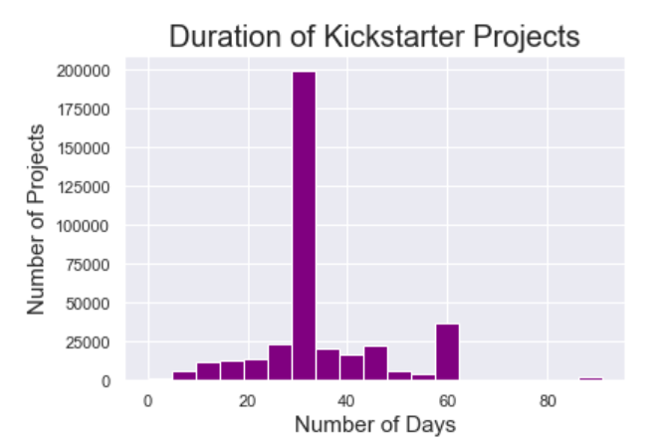
All but three of the projects in the dataset lasted 100 days or fewer. The binsize here is 5 days. The spikes in the data are at the 1-month and 2-month marks, the most popular lengths of time for Kickstarter projects

Slide 7
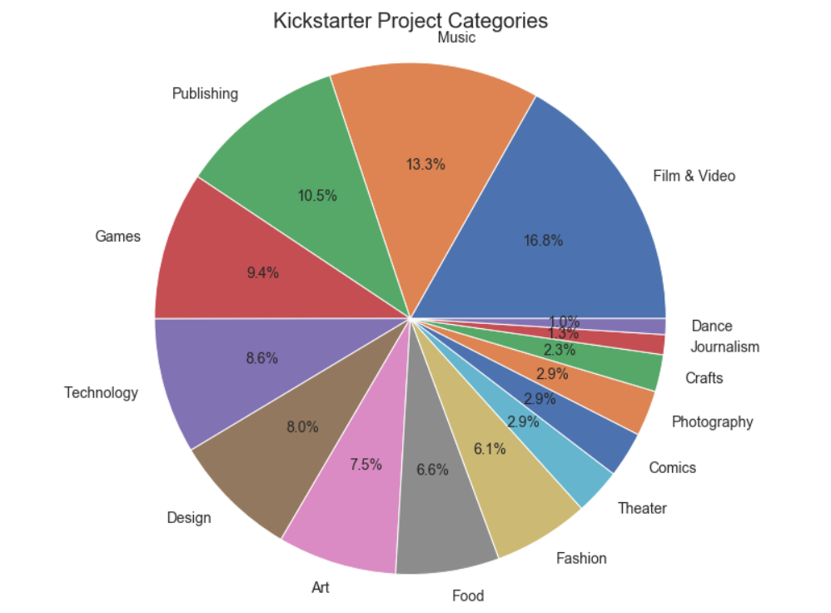
There are 15 different Kickstarter project categories.
The most popular is film & video, and the least popular are dance and journalism.

Slide 8
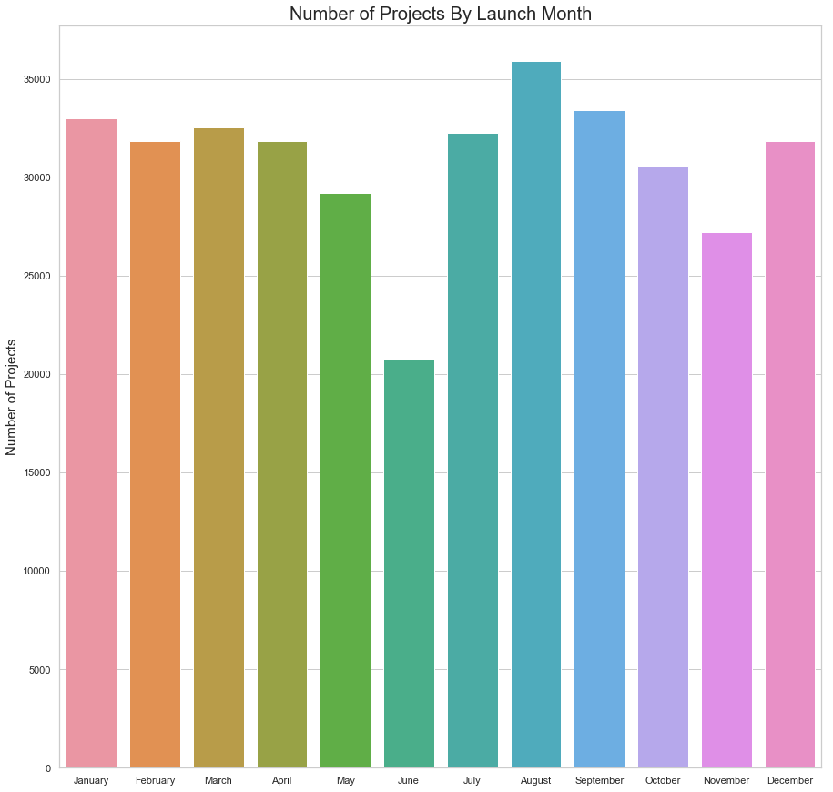
This is the distribution of projects based on launch month. The most popular months to launch Kickstarter projects is late summer, and the least common month to launch is June.

Slide 9
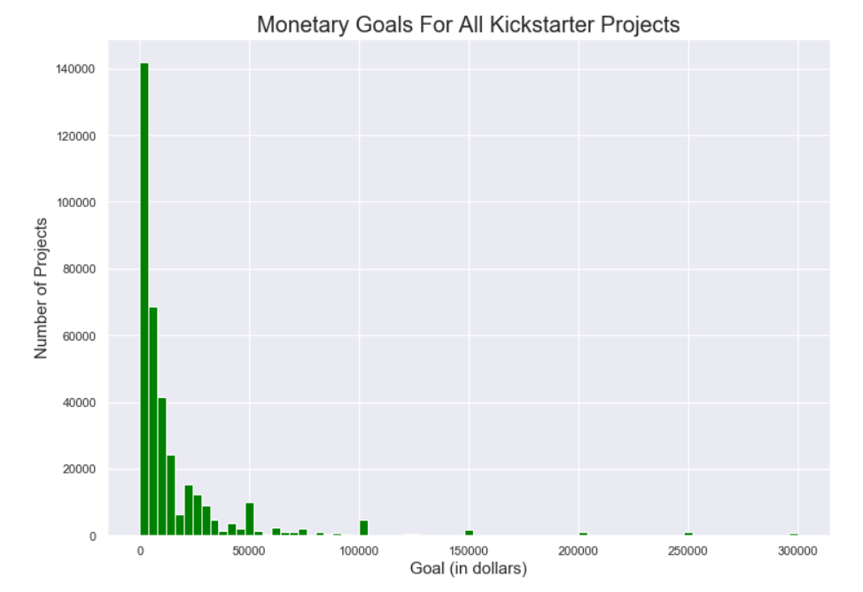

Slide 10
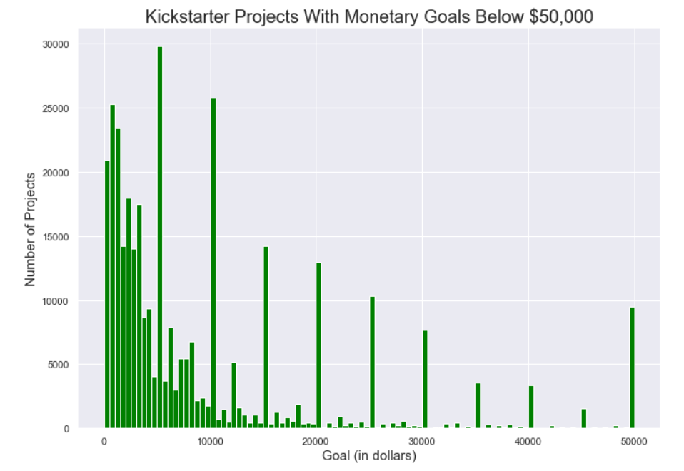
Ninety percent of projects launched had a monetary goal of $50,000 or less. The binsize here is $500. Most of the projects are concentrated under $10,000. There are spikes in the data at the 10s of thousands.

Slide 11
Selecting a Model

Slide 12
Models I Considered
Model | Predictive Power on Test Data
Naive Bayes | 65.19%
k-NN | 63.81%
Logistic Regression | 63.96%
Lasso Regression | 66.99%
Ridge Regression | 63.96%
Decision Tree | 63.96%
Random Forest | 64.31%

Slide 13
Landing on Lasso Regression
Chosen for both the highest predictive power (67%) and potential for explanatory power
By looking further into the coefficients, it was clear that the following features played the biggest role in whether or not a Kickstarter project is successful:

Slide 14
Improving Random Forest
After using lasso regression to eliminate the less significant features, I included only the relevant features in the input data and re-ran Random Forest.

Slide 15
Practical Use for Model
Kickstarter can increase the likelihood that projects launched on their website will be successful
Entrepreneurs and creatives who will launch a project on Kickstarter can improve the likelihood that their project is successful

Slide 16
Shortcomings of the Model
Needs further analysis into how each of the most significant features impacts the outcome variable

